Slide 1
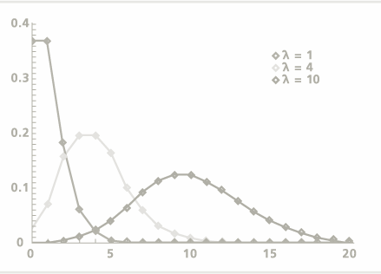
Counting possibilities; Probability distributions
Geog4300/6300
Jerry Shannon

Slide 2

Much of statistics is a probability game
Notes:
Other examples of both? From your fields?

Slide 3
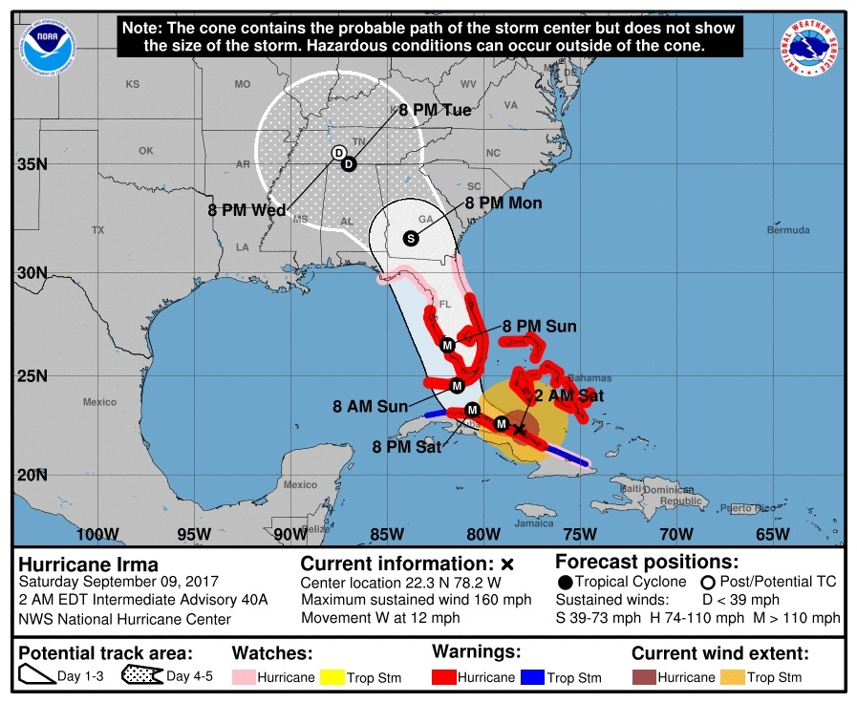
Knowing what’s likely can be useful
Notes:
Other examples of both? From your fields?

Slide 4

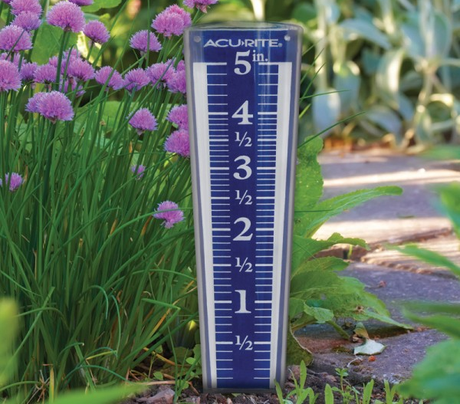
Discrete vs. continuous outcomes
Is there a finite number of outcomes (discrete)?
Or a potentially infinite number of outcomes (continuous)?
Notes:
Other examples of both? From your fields?

Slide 5
Discrete or continuous?
Number of cars parked in a single lot
Times between transit bus arrivals
Area covered by a particular soil type
Number of 90 degree days each July
Family sizes of geography professors
Mass of rocks found at a field site
Number of lightning strikes per minute
Ages of graduate students

Slide 6
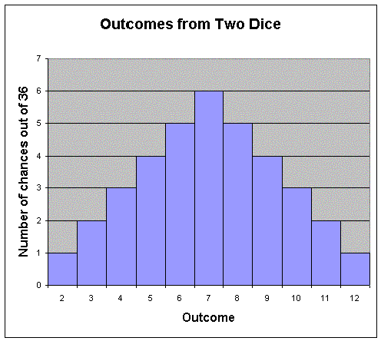
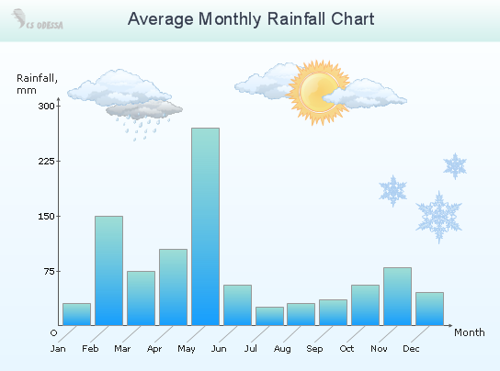
Discrete vs. continuous probabilities
Discrete probabilities: calculate odds of specific outcomes
(e.g., 7 buses in the next hour)
Continuous probabilities: calculate odds of outcome ranges
(e.g., between 3 and 4
inches of rain this month)

Slide 7
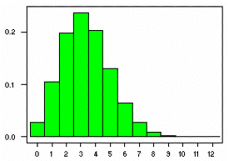
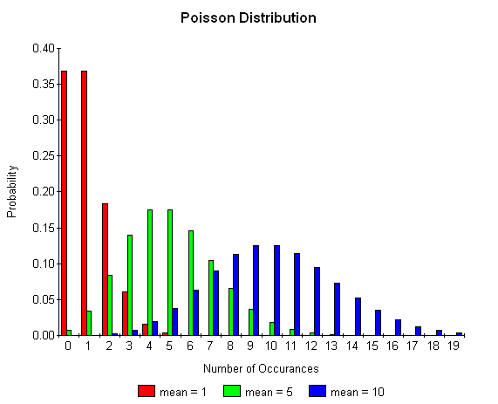
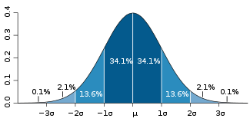
Distributions
Binomial distribution
Poisson distribution
Normal distribution
Notes:
Notice that two of these are discrete distributions, while the normal distribution is continuous.
All help us estimate probability of an event occurring, however.

Slide 8
Binomial distribution: Probability of 1 out of 2 outcomes
What’s the probability of a certain outcome happening x times over n trials?
Each probability is determined separately
Notes:
Examples: Floods, Disease, Cards

Slide 9
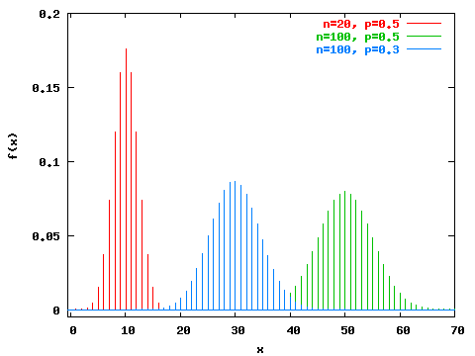
Notes:
Examples: Floods, Disease, Cards

Slide 10
Binomial distribution
X= # of “successes”
N= # of trials
P = probability of success
q = probability of failure
n! p^{x} q^{n-x}
P(x) =
x! (n-x)!
Notes:
Examples: Floods, Disease, Cards

Slide 11

What’s the probability of getting one two pair hand in three separate deals?
P(two pair in one hand) = .048
Q = 1-.048 = .952
X = 1
N = 3
n! p^{x} q^{n-x}
P(x) =
x! (n-x)!
3! (.048)¹ (.952)²
P(1) =
1! 2!
P(1) =
(6) (.048) (.906)
2
P(1) = .131

Slide 12
What’s the probability of getting two or more two pair hands in five separate deals?
P(two pair in one hand)=.048
X=2, 3, 4, 5
N=5
n! p^{x} q^{n-x}
P(x) =
x! (n-x)!
P(2) = .0198
P(3) = .001
P(4) = .00003
P(5) = .0000003
P(>=2)=.0208
Notes:
Should come out to .020906

Slide 13
You try it!!
What’s the probability of getting one hand with three of a kind in five separate deals?
P(3 of a kind) =0.0475
n! p^{x} q^{n-x}
P(x) =
x! (n-x)!
n! = 5! = 120
p^{x} = 0.0475¹
q^{n-x} = (1-0.0475)⁵⁻¹ = .82311
(n-x)! = 24
P(1) = .196
X= # of “successes”
N= # of trials
P = probability of success
q = probability of failure
Notes:
Should come out to .020906

Slide 14
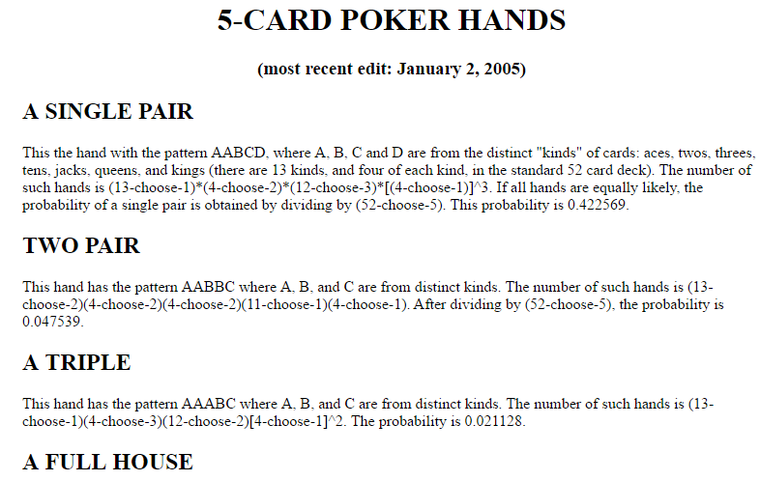
You try it!
Deal five poker hands. How many three of a kind hands do you get?
Link

Slide 15

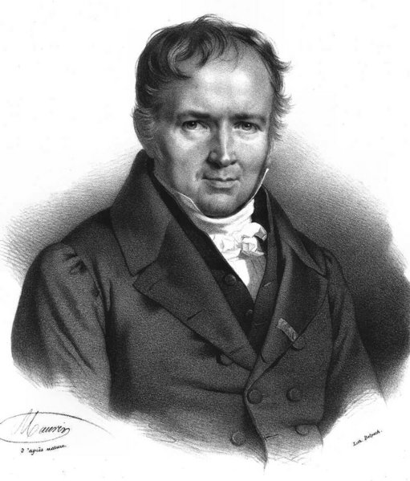
Poisson distribution
What is the probability of x number of events within a given period when these events occur randomly with an expected frequency of λ?
Simeon D. Poisson

Slide 16
Binomial | Poissson
Probability expressed as a statistical constant | Probability is frequency of an event over time or space
Predicts # of successes per # of trials | Predicts # of events per unit of time or space
Focuses on probable outcomes of a discrete trial. | Focuses on rate of occurrence for a random event.
Mathematically, the Poisson distribution is derived from the binomial distribution.
It has a large n (e.g., number of days in a year) and a small p (e.g., infrequent floods)

Slide 17
What happens as the mean (lambda) increases?

Slide 18
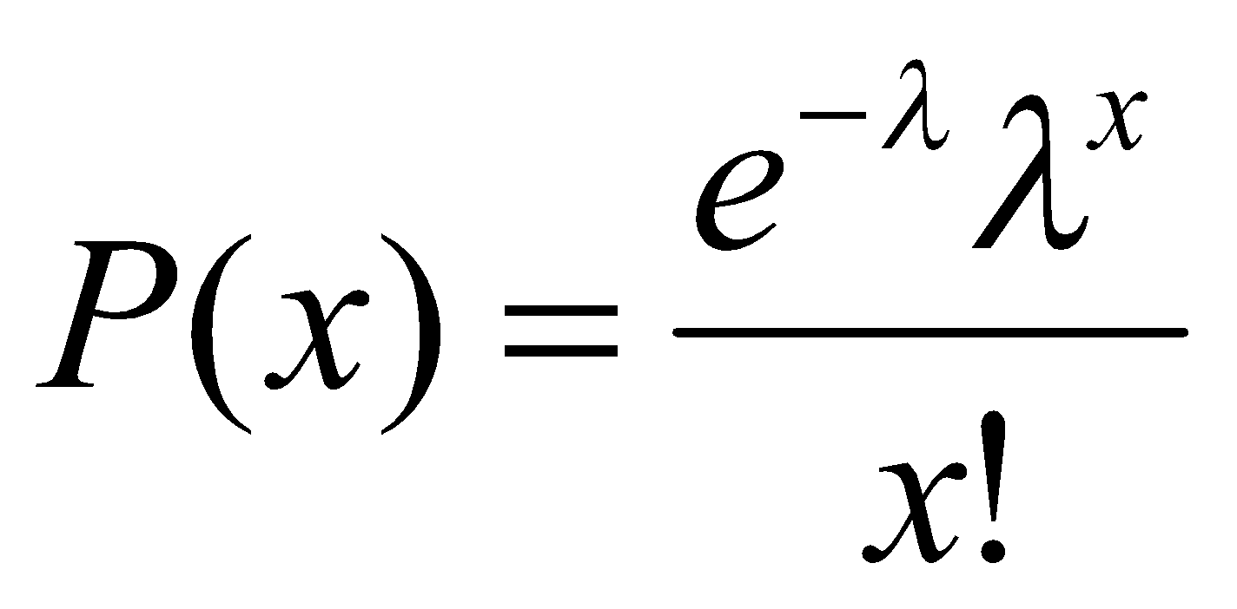
Poisson distribution
λ = rate of occurence per unit time
x = # of occurrences you are testing for
e = 2.71828

Slide 19
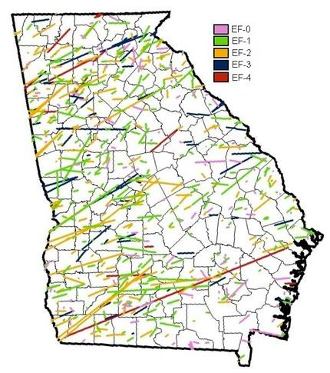
Poisson distribution
Used in point pattern analysis
Given that Georgia has an average of 21 tornadoes per year, what is the probability of a given year having exactly 15 tornadoes?
911stormshelters.com

Slide 20
Poisson distribution
Used in point pattern analysis
Given that Georgia has an average of 21 tornadoes per year, what is the probability of a given year having exactly 15 tornadoes?
(2.718)⁻²¹ (21)¹⁵
P(15) =
15!
P(15) = .04

Slide 21
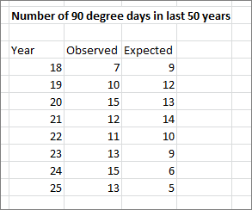

Poisson distribution
Can also be used to determine if a geographical process is random
96five.com

Slide 22

Concept check
The town of Chewandswallow receives random spaghetti storms one day out of every week on average.
A neighborhood group is planning an Italian picnic. What is the chance it will receive two storms in the week prior to this event, so they won’t have to cook?

Slide 23
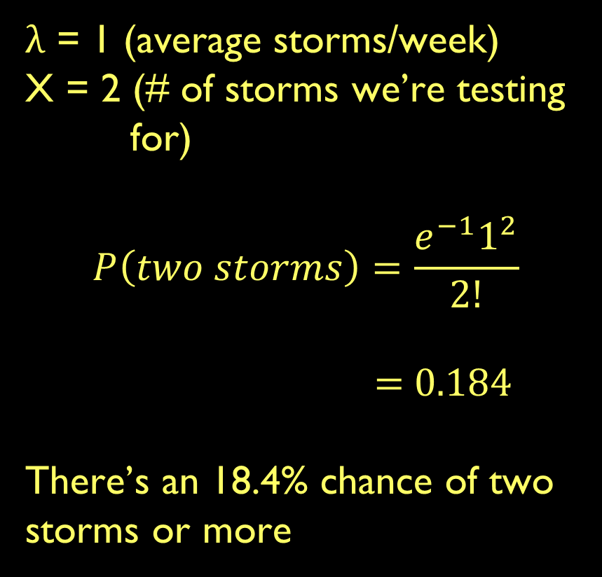
Concept check
λ = 1 (average storms/week)
X = 2 (# of storms we’re testing for)
$$P\left(two storms\right)=\frac{e^{−1}1^{2}}{2!}$$
= 0.184
There’s an 18.4% chance of two storms or more

Slide 24
Normal distribution
A continuous graph that is symmetric around the mean.
Similar to a binomial distribution with an infinite number of outcomes
It is NOT used to calculate discrete outcomes.

Slide 25
Normal distribution
A continuous graph that is symmetric around the mean.
Similar to a binomial distribution with an infinite number of outcomes
It is NOT used to calculate discrete outcomes.

